Slide 1
Java in Android Programming
Jana Batskihh (N8438)

Slide 2
Java
Java was the main Android app language until recently
Kotlin emerged in 2011 and overtook Java in 2019
Many apps are moved or being moved to Kotlin

Slide 3
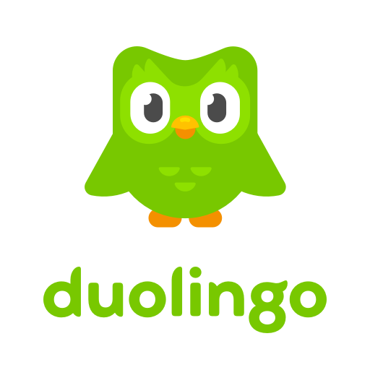

Slide 4
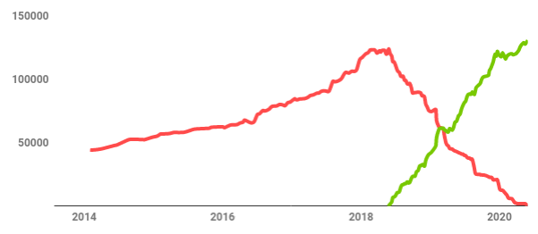
Lines of code in Java (red) and Kotlin (green) over time

Slide 5
Why Kotlin? Duolingo opinion
Productivity: faster and easier to write and maintain code
Stability: null safety features
Developer happiness

Slide 6
How?
Linting: detekt, ktlint, Android Lint, Splinter
Removing Java-specific tools: PMD, SpotBugs
Autoconverter
Fixing compilation errors
Refactoring

Slide 7
My point of view…
Kotlin is the preferable option, but certainly not necessary
Kotlin is easier to understand, but limited in terms of usage
Java can still be used, and it is much more versatile

Slide 8
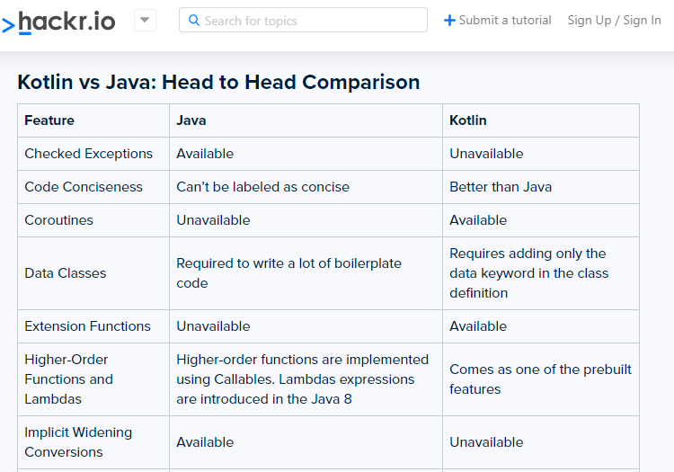

Slide 9
